Slide 1
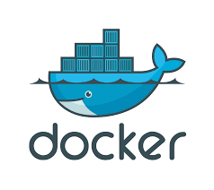
CodeSeeker
DOCKER SETUP ON UBUNTU

Slide 2
CodeSeeker
Install Docker Engine - Community (Install using the repository)
Install packages to allow apt to use a repository over HTTPS:
(type the commands in ubuntu terminal)
----> sudo apt-get install \
apt-transport-https \
ca-certificates \
curl \
gnupg-agent \
software-properties-common

Slide 3
CodeSeeker
Add Docker official GPG key:
----> curl -fsSL https://download.docker.com/linux/ubuntu/gpg | sudo apt-key add -
Verify that you now have the key with the fingerprint:
----> sudo apt-key fingerprint 0EBFCD88

Slide 4
CodeSeeker
Use the following command to set up the stable repository. To add the nightly or test repository, add the word nightly or test (or both) after the word stable in the commands below.
----> sudo add-apt-repository \
"deb [arch=amd64] https://download.docker.com/linux/ubuntu \
$(lsb_release -cs) \
stable"

Slide 5
CodeSeeker
Install Docker Engine - Community
Update the apt package index:
----> sudo apt-get update
Install the latest version of Docker Engine - Community and containerd, or go to the next step to install a specific version:
----> sudo apt-get install docker-ce
Check theDocker version :
----> sudo docker -v

Slide 6
CodeSeeker
Verify that Docker Engine - Community is installed correctly by running the hello-world image:
----> sudo docker run hello-world
check docker images:
----> sudo docker images
check compiled images:
----> sudo docker ps -a

